Slide 1


BUILD YOUR OWN CAR Web Application
By Samskruthi Akkaladevi

Slide 2
Build Your Car : GTA-iX
We need to able to customize a car before purchasing. Show a list of cars as cards on a page.
Each card should show:
Car image
Name and Description
Build and Buy button
By clicking on Build and Buy button it should take you to the customization page.
Upon selecting the features show the price and end product .
All pages should be fully responsive on mobile and tablets. Use your creativity in arranging the fields and images.

Slide 3
Technologies Used:
HTML – Basic Web Page Structure
CSS – To style the web design and Media Queries to set ViewPort.
JavaScript – All the features, functionalities and rendering data to make the web page dynamic.

Slide 4
My Approach
Designed the web page first followed by styling and adding of functionalities.
Used JSON to render the data and make the page dynamic.
Added functionalities in javaScript to customize the car based on the colors applied, some interior and exterior styles.
Made the page responsive in mobile and tablet view.

Slide 5
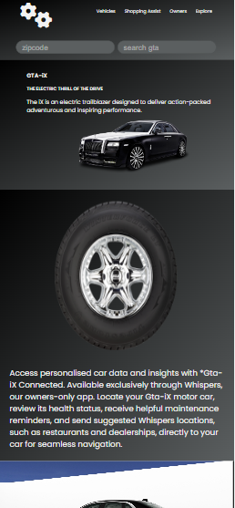
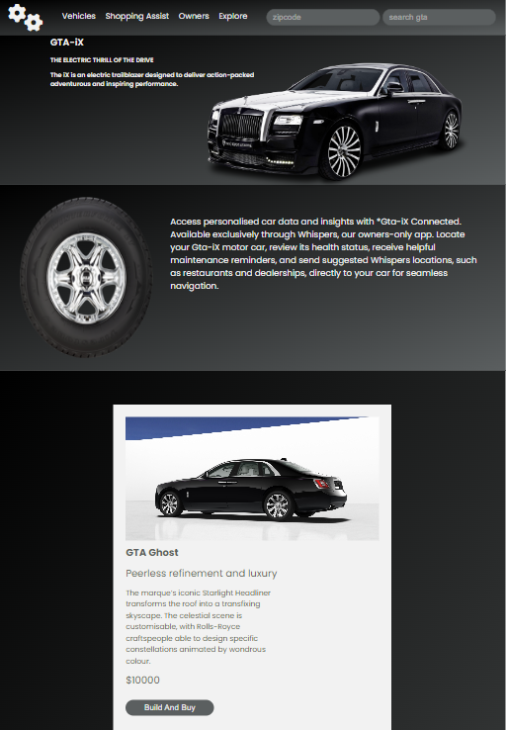
Responsiveness
Mobile View
Tablet View

Slide 6


Thank You

